Slide 1
Small Business, Entrepreneurship, and Franchises

Slide 2
Learning Objectives
Define what a small business is and recognize the fields in which small businesses are concentrated.
Identify the people who start small businesses and the reasons why some succeed and many fail.
Assess the contributions of small businesses to our economy.
Describe the advantages and disadvantages of operating a small business.
Explain how the Small Business Administration helps small businesses.
Explain the concept and types of franchising.
Analyze the growth of franchising and its advantages and disadvantages.

Slide 3
Small Business: A Profile
A small business is one that is independently owned and operated for profit and is not dominant in its field.
99.7% of all employer firms
Employ about half of all private sector employees
Pay 43% of total U.S. private payroll
Have generated 64 percent of net new jobs over the past 18 years
Hire 43% of high-tech workers
Are 52% home-based and 2% franchises
Produce 16.5 times more patents per employee than large patenting firms
Notes:
Additional Resources
Website
Wall Street Journal
Small Business
http://online.wsj.com/public/page/small-business.html?mg=reno64-wsj

Slide 4

The Importance of Small Businesses:
Providing Employment
Small firms...
Hire a larger proportion of younger and older workers, women, and part-time workers
Provide 67% of workers with their first job and initial job skills
Represent 99.7% of all employers and employ over 50 percent of the private work force
Provide 2/3 of the net
new jobs added to the
economy

Slide 5
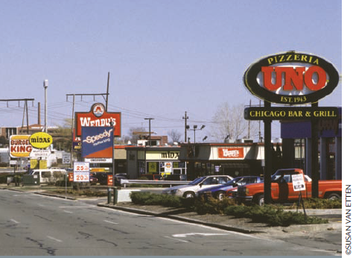

The Importance of Small Business:
Competition and Filling Needs
Providing competition
Small firms can compete with large firms, forcing the larger firm to become more efficient and responsive to customer needs.
Filling needs of society and other businesses
Small firms can meet the special needs of smaller groups of customers.
Small firms can act as specialized suppliers of goods and services to larger businesses.

Slide 6

The Importance of Small Businesses:
Technological Innovation
Small firms...
Employ 43% of all high-tech workers
Produce 2.5 times as many innovations as large firms relative to the number of persons employed
Produce 16 to 17 times more patents per employee than large patenting firms
Mark Zuckerberg founded Facebook while still a
student at college.

Slide 7



20th Century Innovations
Originated at Small Firms
© FRANCK BOSTON/SHUTTERSTOCK
© BOJANOVIC/SHUTTERSTOCK
© JULIAN ROVAGNATI/SHUTTERSTOCK

Slide 8
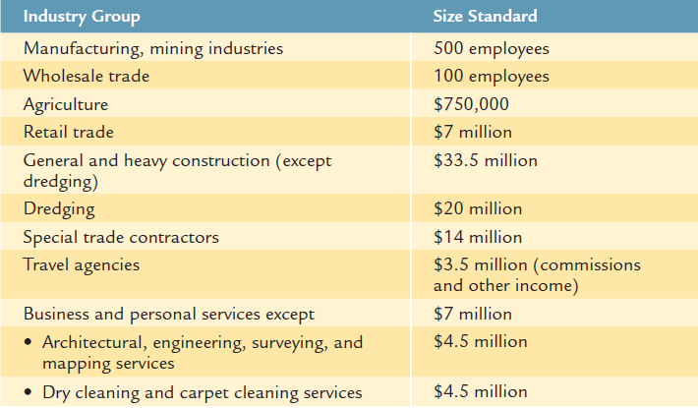
Small Business:
Industry Group-Size Standards
In the U.S., 99.7% of all businesses are considered small.
Notes:
Source: www.sba.gov/content/summary-size-standards-industry
Additional Resources
Article
CNN
Fact Check: Is Donald Trump a Small Business?
10/5/12
http://www.cnn.com/2012/10/04/politics/fact-check-trump-small-business/index.html

Slide 9



Small Business:
Attractive Characteristics
Low capital
investment
Some special skill requirements
High growth and profit potential
© ARKA38/SHUTTERSTOCK

Slide 10
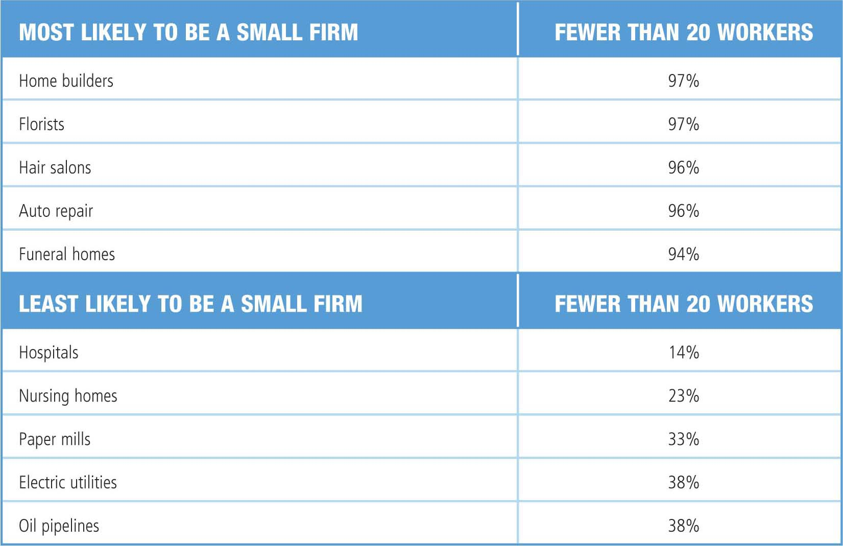
Typical Small-Business Ventures

Slide 11

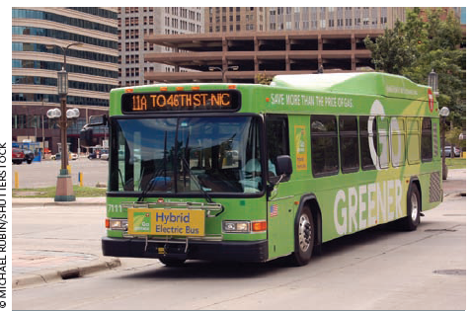
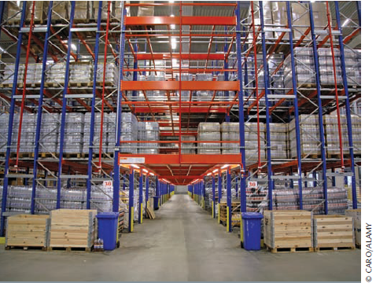

Small Business: Distribution – 33%
Retail
Transportation
Wholesale
Communication

Slide 12
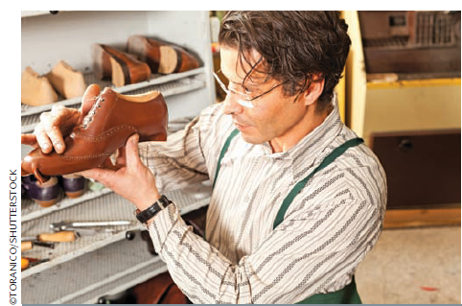


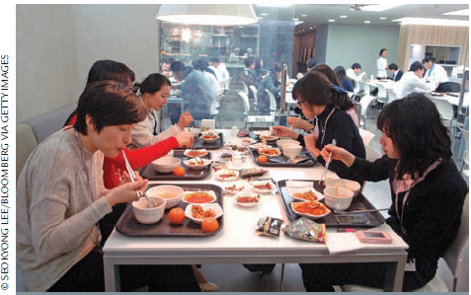
Small Business: Service – 48%
Medical and Dental Care
Watch, TV, and Shoe Repair
Financial Services
Restaurant Meals

Slide 13

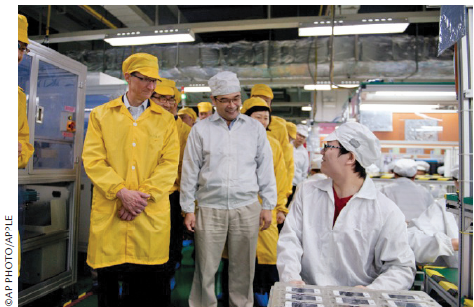
Small Business: Production – 19%
Construction, Mining, and Manufacturing

Slide 14
Small Business: Lifespan
Percent of New Businesses That Survive over Time
Percent
Years
The primary reason for failure is mismanagement resulting from lack of business know-how.
Notes:
14

Slide 15



Why Some Entrepreneurs and Businesses Fail
Lack of capital and cash-flow problems
Lack of management skills
Overexpansion

Slide 16
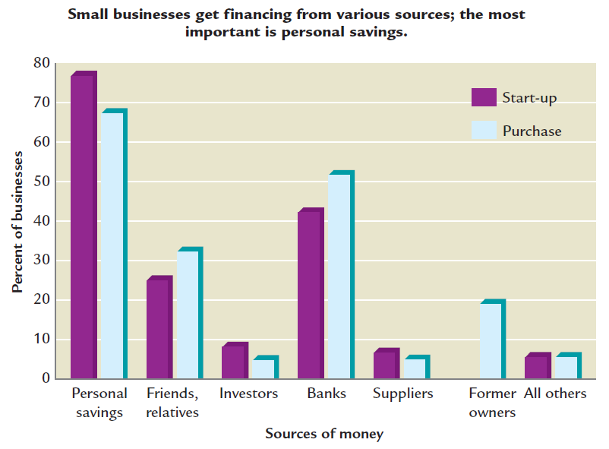
Sources of Capital for Entrepreneurs
Notes:
Source: Data developed and provided by the National Federation of Independent Business Foundation and sponsored by the American Express Travel Related Services Company, Inc.

Slide 17
Developing a Business Plan
A business plan has three basic purposes:
  To communicate to potential investors
  To manage progress
  To plan the various phases of business
Should answer:
  What is the nature and mission of new venture?
  Why is it a good idea?
  What are the goals?
  How much will it cost?
Notes:
Additional Resources
Website
SBA.gov
Create Your Business Plan
http://www.sba.gov/category/navigation-structure/starting-managing-business/starting-business/how-write-business-plan
Entrepreneur.com
Your Business Plan Guide
http://www.entrepreneur.com/businessplan/index.html

Slide 18
Components of a Business Plan
Introduction
Executive Summary
Benefits to the Community
Company and Industry
Management Team
Manufacturing and Operations Plan
Labor Force
Marketing Plan
Financial Plan
Exit Strategy
Critical Risks and Assumptions
Appendix
Notes:
Additional Resources
Sample business plans
http://www.entrepreneur.com/landing/216013

Slide 19
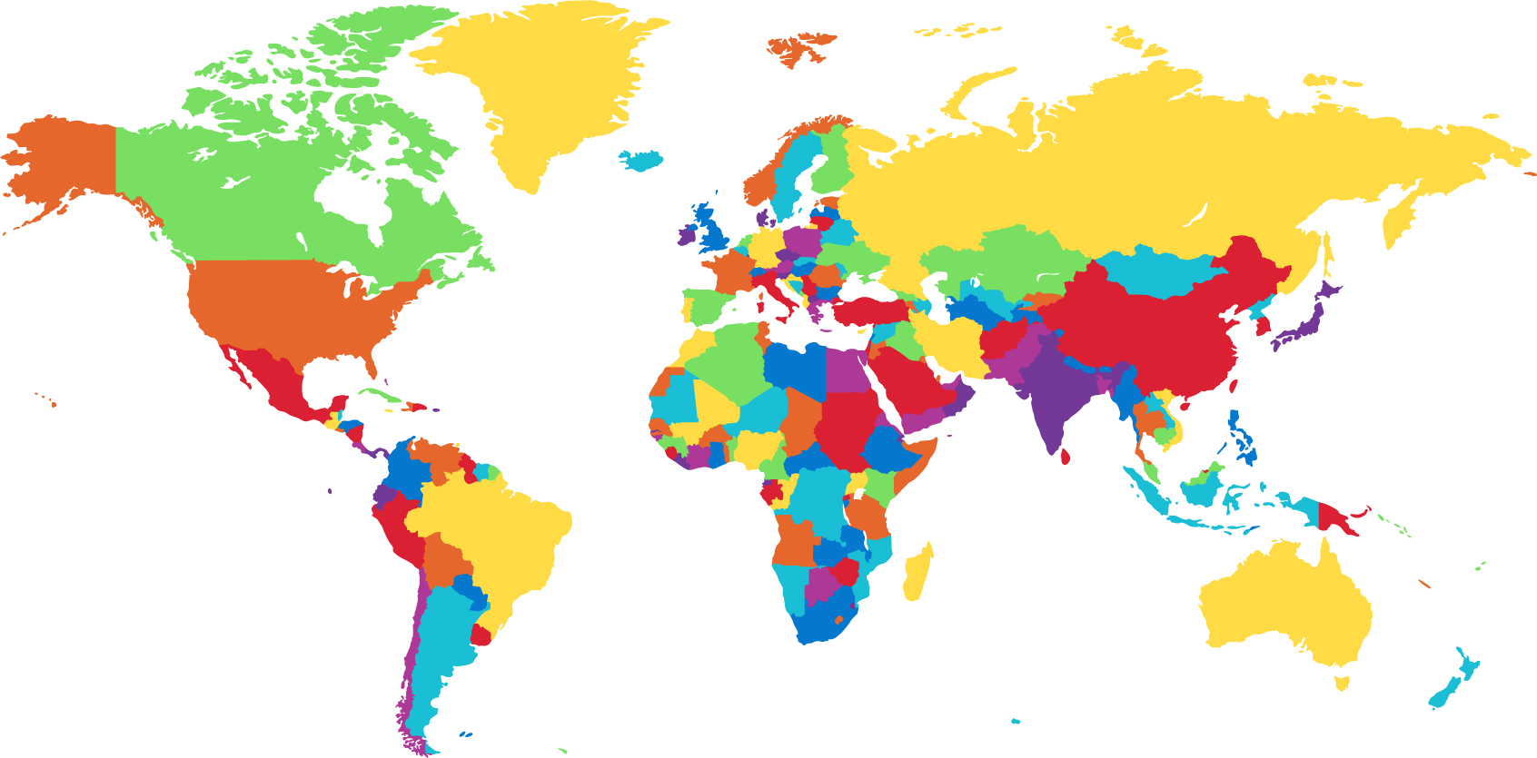
The Entrepreneurial Spirit
Percent of people who would rather work for themselves than for someone else
58%
46%
70%
© ILDOGESTO/SHUTTERSTOCK
Notes:
Additional Resources
Website
Innovision Technologies
http://www.innovisiontech.com/_site/about.html

Slide 20
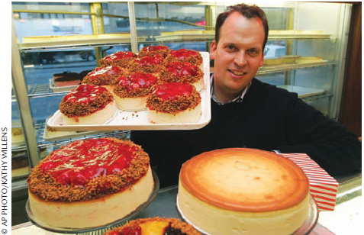
The People in Small Businesses:
The Entrepreneurs
Entrepreneurial spirit is the desire to create new business. What are some reasons people want to start their own businesses?
Notes:
Additional Resources
Website
Entrepreneur
http://www.entrepreneur.com/

Slide 21
Characteristics of Entrepreneurs
Independence
A desire to determine one’s own destiny
A willingness to find and accept challenges
Family Background
Age
Also:
Self Confidence
Optimism
Tolerance for failure
Tolerance for ambiguity

Slide 22
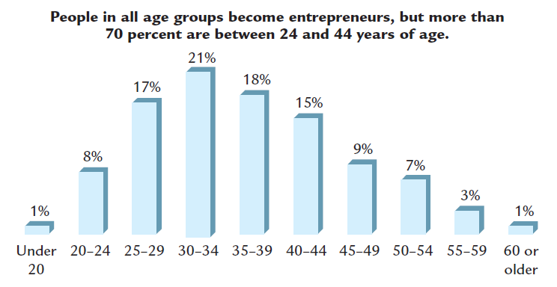
How Old Is the Average Entrepreneur?
Source: Data developed and provided by the National Federation Independent Business Foundation and sponsored by the American Express Travel Related Services Company, Inc.
Notes:
Additional Resources
Website
Crain's: New York Business
40 Under 40
http://mycrains.crainsnewyork.com/40under40/

Slide 23

Women as Small-Business Owners
Own 7.8 million businesses
Provide 7.6 million jobs
Generate $1.2 trillion
in sales
More than 40% have been in business 12 years or more
Own 66% of home-based businesses

Slide 24

Teenage Entrepreneurs
What challenges do teenage entrepreneurs face?
Do they
have any advantages?
Mary Rodas, Catco, Inc., VP of Marketing at age 14
Notes:
Additional Resources
Article
Business Insider
These 10 Pre-teen Entrepreneurs Make Millions More Than Their Parents
9/27/10
http://www.businessinsider.com/these-pre-teen-entrepreneurs-make-millions-more-than-their-parents-2010-9?op=1
Website
Under30CEO.com
http://under30ceo.com/30-most-influential-young-entrepreneurs-of-2011/
CNBC
20 Under 20
http://www.cnbc.com/id/45243912/
Slideshow
Teen Entrepreneurs
http://www.cnbc.com/id/48571760/Teen_Entrepreneurs

Slide 25
Advantages and Disadvantages of
Small Business Ownership
Advantages
Personal relationships with customers
Ability to adapt to change
Simplified record keeping
Independence
Profit retention
Ease of start-up
Ability to keep secrets
Disadvantages
High risk of failure
Limited potential
Limited ability to raise capital

Slide 26



Using the Internet
Several websites provide helpful information about writing a business plan.
http://www.sba.gov/
http://www.score.org
http://www.entrepreneur.com/businessplan/index.html

Slide 27
The Small Business Administration
A governmental agency that assists, counsels, and protects the interests of small business
in the U.S.
SBA management assistance
  Management courses and workshops
  Service Corps of Retired Executives (SCORE)
Help for minority-owned small businesses
  Small-business institutes (SBIs)
  Small-business development centers (SBDCs)
  SBA publications

Slide 28
The Small Business Administration:
Financial Assistance
The SBA partially guarantees regular business loans.
  SBA will repay 90% of loan if the borrower cannot replay it.
  Loans may be as large as $2 million.
  Average loans are $300,000 over eight years.
© ARKA38/SHUTTERSTOCK

Slide 29

The Small Business Administration:
Financial Assistance (cont'd)
The SBA licenses, regulates,
and provides financial
assistance to small-business
investment companies
(SBICs).
  SBICs: privately owned
  firms that provide venture
  capital to small enterprises that meet
  their investment standards
  Venture capital: money invested in small firms that have the potential to become very successful

Slide 30
Using the Internet
The Small Business Administration offers a wide variety of management and financial assistance to small businesses. It also offers a wealth of statistics about small business. For research and statistics related to small business, visit its website.
http://www.sba.gov/advocacy/847

Slide 31
Other Specialized Assistance
Set-Aside Programs
  Government Contracts (23% of prime contract dollars)
    5% for women and minorities
  Assistance in Financing Government Procurement
Business Incubators
  Local community initiatives to share resources for small start-ups
    SCORE: Counselors to America’s Small Business
    Small Business Development Centers (SBDC)
OU Incubators: Rochester Hills (Clean Energy, Medical Devices, Information Technology) & Macomb (Defense, Homeland Security, Advanced Manufacturing)

Slide 32

Global Perspectives in Small Business
National and international economies are growing more interdependent.
Trade barriers are diminishing.
Number of businesses exporting goods and services has tripled since 1990—2/3 of which have fewer than 20 employees.
© FIKMIK/SHUTTERSTOCK

Slide 33
Global Perspectives in Small Business:
Government Assistance
The SBA helps U.S. small business owners enter world markets.
  Matches executives with potential overseas customers
  Helps exporters secure financing
  Brings small U.S. firms into direct communication with overseas buyers and partners
  SBA International Trade Loan guarantees up to $5 million in loans
The U.S. Commercial Service aids small and medium-sized businesses in selling overseas and has 251 offices in 76 countries.
Notes:
Additional Resources
Report
The Dorrian Consulting Group
The Challenges Facing Small Business: A Global Perspective
http://www.dorriangroup.com/docs/NewsNov2005.pdf

Slide 34

Global Perspectives in Small Business
Nanmac Corporation
Small business in
Framingham, MA
Export strategy led to
doubled sales in 2009, to $5.1 million
Number of employees increased 80%
Strong presence in China, Latin America,
Singapore, and Russia
Relies on advice from Massachusetts
Small Business Development Center
Received SBA’s 2010 Small Business Exporter
of the Year Award
Notes:
Additional Resources
Article
Framingham-based NANMAC Corporation Wins National SBA Small Business Exporter Award
http://www.mass.gov/export/news/press_nanmac.htm

Slide 35
Global Perspective on Developing Economies
  Microfinance is the supply of loans, savings, and other basic financial services to the poor.
  Help the poor start or expand businesses in impoverished places.
    $360 to supply fresh water in Dar es Salaam, Tanzania
    $400 for vegetable oil stand in Lagos, Nigeria
    $200 to start knitting business in La Paz, Bolivia
  Access to financial services empowers the poor by reducing their vulnerability, and offering them opportunities to improve their lives.
  www.cgap.org
  kiva.org - How Kiva works

Slide 36
The Global Focus on Women
If you educate a man you educate an individual, but if you educate a woman you educate a family (nation) (Ghanaian scholar).
Educating girls yields some of the highest returns of all investments in developing nations:
  Reduces child and maternal mortality
  Improves nutrition and health
  Lowers fertility rates
  Enhances women’s domestic role and political participation
  Improves economic productivity and growth

Slide 37

Global Perspectives in Small Business
Why do you think the Internet is cited as a favorite strategy for growth among small business owners?

Slide 38





Franchise
A franchise is a license to operate an individually owned business as though it
were part of a chain of outlets or stores.

Slide 39
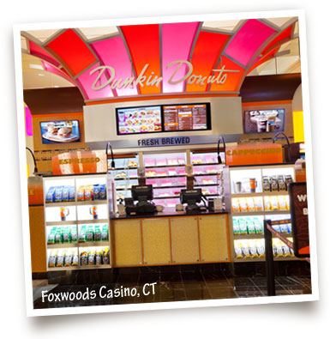



Franchising
Franchise
Agreement
© TUPUNGATO/SHUTTERSTOCK
Franchisor
Franchisee
Notes:
39

Slide 40
Types of Franchises
A manufacturer
authorizes retailers
to sell a certain
brand-name item.
A producer licenses
distributors to sell a
product to retailers.
A franchisor supplies brand names, techniques, or services instead of a complete product.

Slide 41

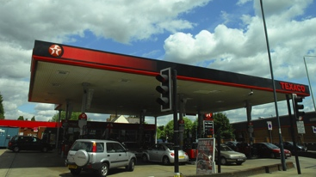
The Growth of Franchising:
Dual-branded Franchises
Two franchises offering their products together
An increasing small business trend since the 1990s
© TOMASZ BIDERMANN/SHUTTERSTOCK
McDonald’s opened its first cobranded restaurant with Texaco in
Beebe, AK in 1993.
© AHMAD FAIZAL YAHYA/SHUTTERSTOCK
Notes:
Additional Resources
Restaurant News: Bruegger's franchisee co-brands units with Jamba Juice
8/16/12
http://nrn.com/article/brueggers-franchisee-co-brands-units-jamba-juice
MCB University Press: How Corporate Names Add Value
http://www.redaksjonen.com/Artikler/57Dualbranding.pdf
Ritchie International
Dual Branding – The New Franchise Phenomenon
http://www.google.com/url?sa=t&rct=j&q=&esrc=s&source=web&cd=1&cad=rja&ved=0CDMQFjAA&url=http%3A%2F%2Fwww.ritchieinternational.com%2FPressReleases35n45%2FDual%2520Branding%2520%2520The%2520New%2520Franchise%2520Phenomenon.doc&ei=VFejUO6zKPK30gGhz4CgCw&usg=AFQjCNEmuVWIuJ0_IBB5sWQxYhEDFHdu3w&sig2=VFyEZO9lkseB-fF0pJ3eaQ
Co-Branding – Here’s What You Have to Know
http://www.google.com/url?sa=t&rct=j&q=&esrc=s&source=web&cd=2&ved=0CDoQFjAB&url=http%3A%2F%2Fwww.ritchieinternational.com%2FPressReleases35n45%2FCo-Branding%2520Heres%2520What%2520You%2520Have%2520To%2520Know%2520to%2520Succeed.doc&ei=mVejUKuXIe7h0wHnwoGwCw&usg=AFQjCNEDdMlZpzDDaR5hVkGAtCdxf7lHhA&sig2=Fdq80AFnnRYJ7VMOAkbkfw

Slide 42
The Growth of Franchising: Success
The success rate for franchises is significantly higher than that for other small businesses.
94% of franchise owners report that they are successful.
Too rapid expansion, inadequate capital or management skills, or other problems can cause franchises to fail.

Slide 43
Diversity of Products and Services
The International Franchise Association lists more than 75 different franchise categories.
Some industry categories:
  Automotive
  Baked Goods
  Building and Construction
  Business Services
  Child-Related Services
  Education-Related Services
  Lodging
  Maintenance Services
  Real Estate
  Travel
  Sports and Recreation
  Printing
Source: www.franchise.org.

Slide 44
Advantages of Franchising
To the Franchiser
  Fast and well controlled
  distribution of its products
  No need to construct and
  operate its own outlets
  More working capital
  available for expanded production and advertising
  Franchising agreements
  maintain product and quality standards
  Motivated work force of
  franchisees
To the Franchisee
  Opportunity to start a proven business with
  limited capital
  Guaranteed customers
  Franchisor available for advice and guidance
  Materials for local promotional campaigns
  and participation in
  national campaigns
  Cost savings when purchasing in cooperation with other franchisees

Slide 45
Disadvantages of Franchising
To the Franchiser
  Failure of the franchisee to operate franchise properly
  Disputes with and lawsuits by franchisees over
  the terms of the franchise
To the Franchisee
  Franchisor retains a large amount of control over the franchisee’s activities
  Franchisor opening competing franchises within the franchisee’s market

Slide 46
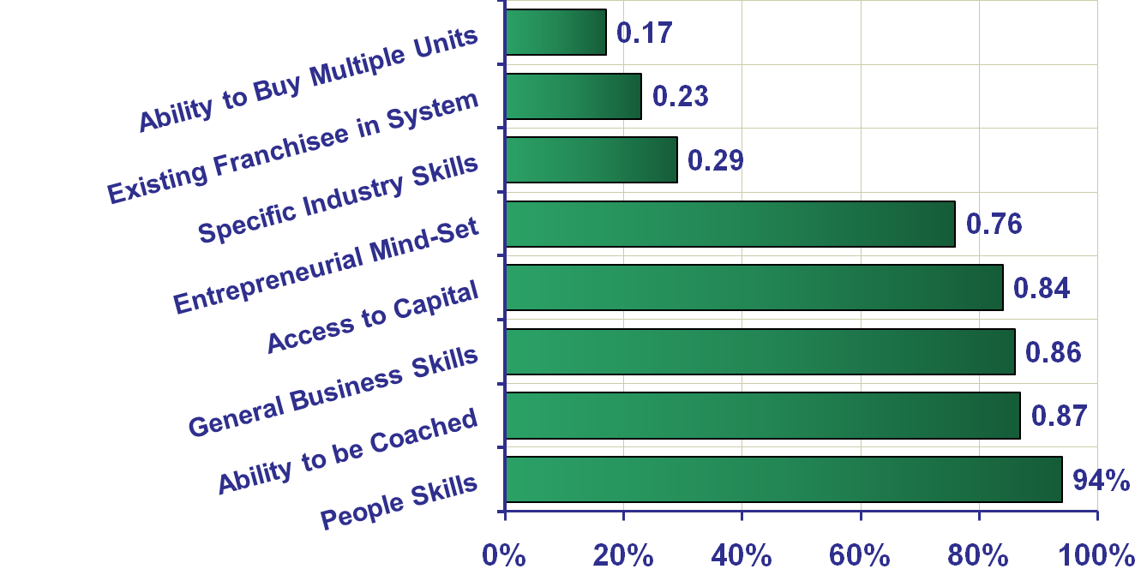
Qualities Franchisors
Seek in Franchisee
Entrepreneur, “The 28th Annual Franchise 500- Top 10 Franchises for 2007”, January 2007, p. 128.
Notes:
46

